Slide 1
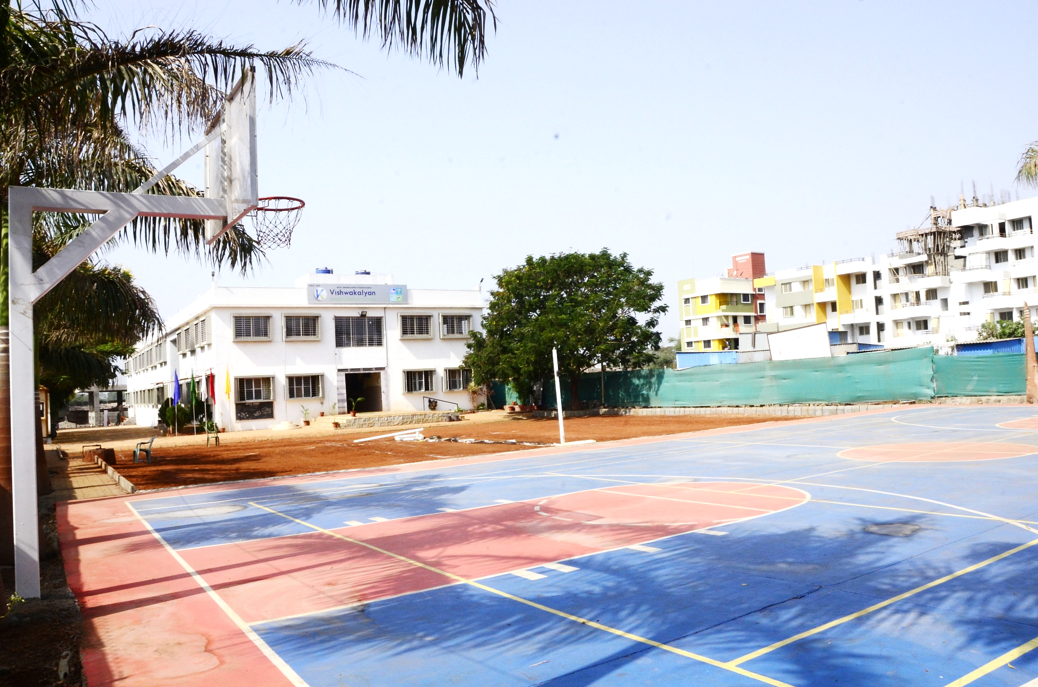

Vishwakalyan School
&
Junior College

Slide 2

Welcome to EPTA
2021-22
Vishwakalyan School & Junior College

Slide 3

Agenda for PTA 2021-22
Date : 03.07.2021
Day : Saturday
Time : 9:30 a.m. to 10:30 a.m.
Venue : School Activity Hall
1) Welcome to all Members
2 ) Elected PTA member's list for the a.y. 2021-22)
3) Achievements
4) Competitive Exams
5) GOF Olympiad
6) Virtual Science Exhibition
7) Questionnaires &
8) Vote of Thanks
Vishwakalyan School & Junior College

Slide 4
EPTA Member List 2021-22
Sr. No. | Name | Designation | Email ID | Phone No.
1. | Mrs. Gayatri Dhamanekar | President / Chairman | principals.vems@gmail.com | 7875551213
2. | Mr. Devendra Bagde | Vice-Chairman (Parent - Member) | deven3017@gmail.com | 9555449125
3. | Mrs. Manisha Gawade | Secretary | manisha.vems@gmail.com | 9657577970
4. | Mrs.Kavita Ghavri | Join Secretary (Parent) | Kavitaghavri0508@gmail.com | 8975897740
5. | Mrs. Shital Waman | Join Secretary (Teacher) | sheetalwaman.vems@ gmail.com | 7720044805
6. | Mrs. Pallavi Gaikwad (I) | Class Teacher | primary coordinator@ vishwakalyanschool.in | 9762374962
7. | Mr.Devendra Bagde | Member | deven3017@gmail.com | 9555449125
8. | Mrs.Varsha Ruikar (II) | Class Teacher | varsha.vems@gmail.com | 7387349070
9. | Mr.Sarwankumar | Member | Sarwank35@gmail.com | 7908102094
10. | Miss Sudha Singh (III) | Class Teacher | sudha.vems@gmail.com | 7987244362
Vishwakalyan School & Junior College

Slide 5
EPTA Member List 2021-22
Sr. No. | Name | Designation | Email ID | Phone No.
11. | Mr.Sohan Choudhary | Member | Sohan727@gmail.com | 9833067383
12. | Mrs. Snehal Balwantrao (IV) | Class Teacher | snehal.vems@gmail.com | 7666213660
13. | Mr.Gautam More | Member | gautam.saachi@gmail.com | 8329818392
14. | Mrs.Vandana Shinde (V) | Class Teacher | vandana.vems@gmail.com | 7620214206
15. | Mrs.Kavita Ghavri | Member | Kavitaghavri0508@gmail.com | 8975897740
16. | Mrs.Shradha Joshi (VI) | Class Teacher | shradhajoshi.vems@ gmail.com | 7757010614
17. | Mrs.Manisha Chepte | Member | cheptemanisha@gmail.com | 9359166241
18. | Mrs.Rajni Yadav (VII) | Class Teacher | rajni.vems@gmail.com | 9689010593
19. | Mrs. Namita Mehta | Member | namitamehta65@gmail.com | 8308221441
20. | Mrs. Rupali Siddhani VIII) | Class Teacher | rupalisiddani@gmail.com | 9011388560
Vishwakalyan School & Junior College

Slide 6
Achievements
CYBER CHAMP 2021
Inter school competition held online in the month of February 2021
The winners of the competition are:
Kalpak Patil - MS Paint Junior
Pratik Dhage - Exploring Animation with PowerPoint
Rajnandini Bhosale - MS Paint Junior
Riddhika Patil - MS Paint Junior
Risika Wagh - Exploring Animation with PowerPoint
Shailesh Jadhav - Ideas & Innovation
Soham Gade - Ideas & Innovation
Vishwakalyan School & Junior College

Slide 7

Swach Bharat
Art Excellence Award
Vishwakalyan School & Junior College

Slide 8
Competitive Exams
Exam |  | Tentative Month
SOF – IGKO | : | October
SPELL Bee | : | October
SOF – IEO | : | October
SOF – NSO | : | November
SOF – IMO | : | November
SOF – NCO | : | December
Abacus & Vedic Maths | : | January
I-Qube | : | February
Vishwakalyan School & Junior College

Slide 9
GOF Olympiad
1. GOF Olympiad is *National Level competitive exam* that covers more than 3.5 lakh students across 3900+ schools.
2. GOF Olympiad is India's leading *App based Olympiad platform* - focusing on effective concept learning and efficient exam skills.
3. Three customized subjects are offered - *GOF Maths Olympiad*, *GOF Science Olympiad*, and *GOF English Olympiad*.
4. The GOF Olympiad Android App can be downloaded from Google Play Store link - (https://play.google.com/store/apps/details?id=io.gof.gofapp) or from our website http://www.GOFolympiad.org
5. The students/parents can *directly register* on GOF Olympiad Android app.
6. GOF Maths Olympiad and GOF Science Olympiad questions are based on *Bloom's Taxonomy of educational objectives* - the participants are encouraged and motivated to move up the ladder of learning objectives.
7. GOF English Olympiad questions are based on *Webb's Depth Of Knowledge model* - the participants are encouraged and motivated to move up from DOK Level 1 to DOK Level 4.
Vishwakalyan School & Junior College

Slide 10
GOF Olympiad
8. To prepare for Olympiad Exam - the GOF Olympiad App provides *SEVEN mock-tests per subject*.
9. Every mock-test has two versions - one *timer based* and other one *without-timer*. The without-timer mock test prepares students for concept learning and correctness of the same. And, the timer based mock test prepares students time management - makes them focus on timely completion of the tests.
10. There are two levels of Olympiad Exams - *Zonal Level* and *National Level* Olympiads.
11. We have highest students to *awards ratio of 1:10* - offering many awards like *Amazon Kindles, Tablets, Cash vouchers* of *Rs.1000* and *Rs.500*, and *Gold Medals* as per performance in National Level exam.
12. Fee for one subject is Rs. 300, for two subjects Rs. 550, and for all three subjects it is
Rs. 800.
13. The fee can directly be paid online through the App.
14. *Dedicated customer service* through email (contact@GOFOlympiad.org) and mobile
(+91 845-987-0848).
Vishwakalyan School & Junior College

Slide 11
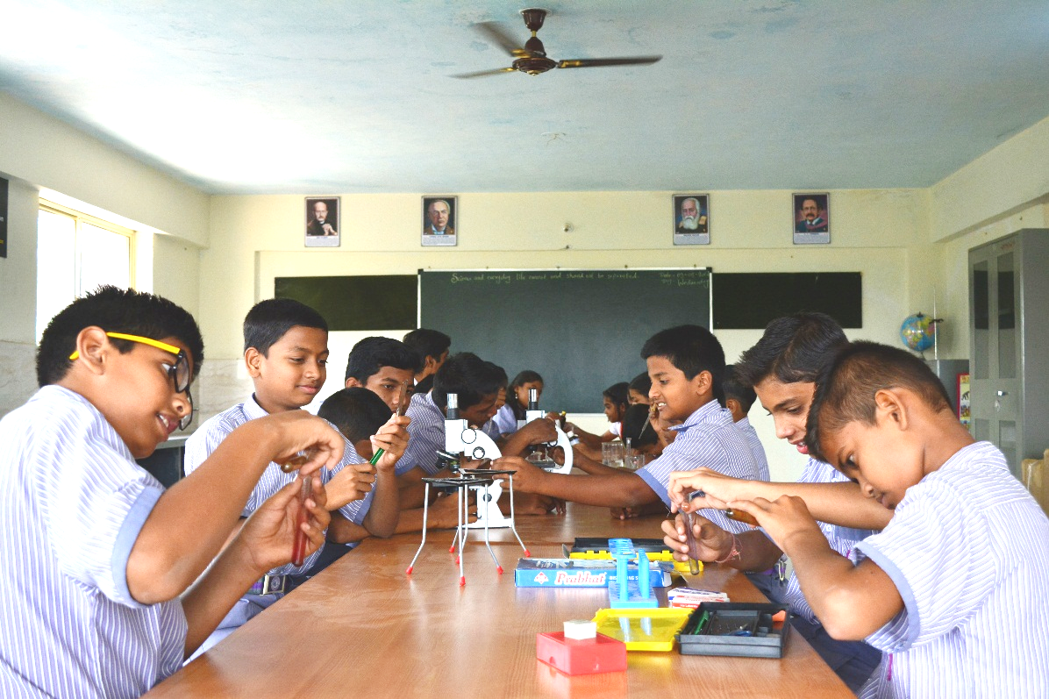
Virtual Science Exhibition
We will be conducting "Virtual Science Exhibition" to inculcate a scientific attitude, where students will showcase their talents on creativity & innovation.
• Science Exhibition •
Date : 6th October 2021 Class: Grade-VI to Grade-X
Vishwakalyan School & Junior College

Slide 12
Vishwakalyan School & Junior College

Slide 13
Vote of Thanks
Vishwakalyan School & Junior College

